Slide 1
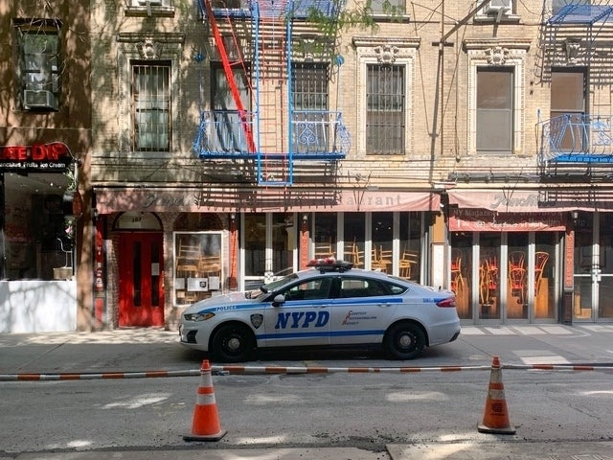
Crime Data and Spending: NYC
Jeffrey Dean, Xiyuan Zhang

Slide 2
Background Context
In the wake of the Covid-19 pandemic, there is a focus on governments to raise spending, with places like New York City already at a historical level of spending. But with this level of spending, is there a notable improvement to quality of life given the cost?
NYC has worked to improve quality of life and specifically to reduce levels of crime in the city. So we sought to see if there is a historical relationship between higher spending and changes in level of different types of crimes.
Our question becomes: do higher spending levels in key agency spending have a relationship to levels of crime over the time period 2000-2020?

Slide 3
Data Measurement
The data used compares two sets of information from official sources for the City of New York
Agency Expenditures: Education, City University, Police (NYPD), Youth and Community Development, and Social Services
Crime Data: Murder, Robbery, Total Felony Offenses

Slide 4
Methodology
Two methods are used to compare spending to crime data.
Descriptive statistics over the time period
Comparative information graphs given the relationships over time

Slide 5
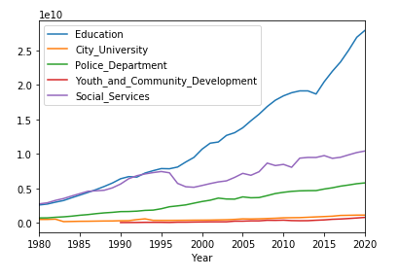
Agency Expenditures Over Time

Slide 6
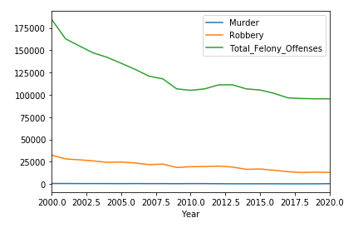
Crime Data Over Time

Slide 7
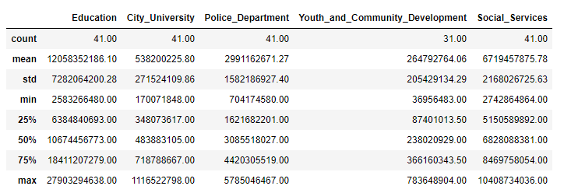
Agency Expenditure Descriptives

Slide 8
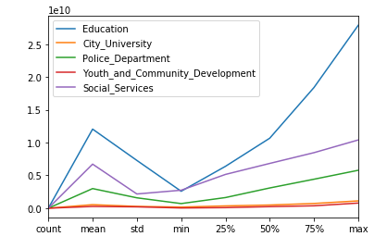
Agency Expenditure Line Plot

Slide 9
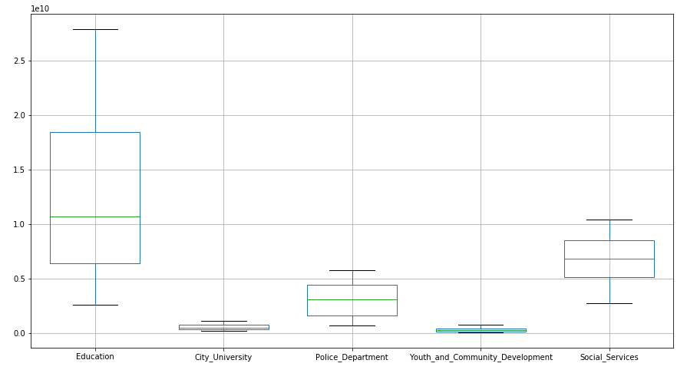
Agency Expenditure Box Plot

Slide 10
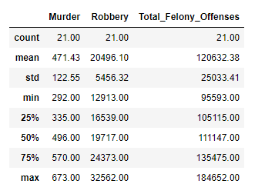
Crime Data Descriptives

Slide 11
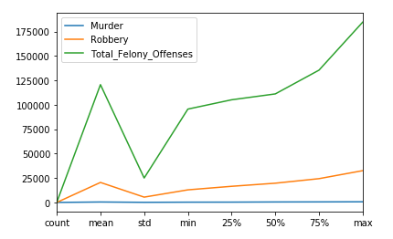
Crime Data Line Plot

Slide 12
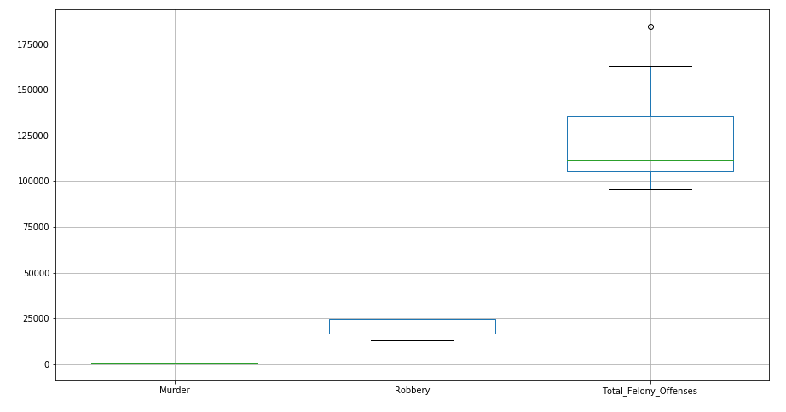
Crime Data Box Plot

Slide 13
Comparative Plots
The following plots are split by agency expenditure and compares to each type of crime.
These plots are useful to support where spending is related to changes in crime, given the fixed period of time 2000-2020.
From the graphs we can support a conclusion using the comparative graphs and we can see any changes in patterns that can occur.

Slide 14
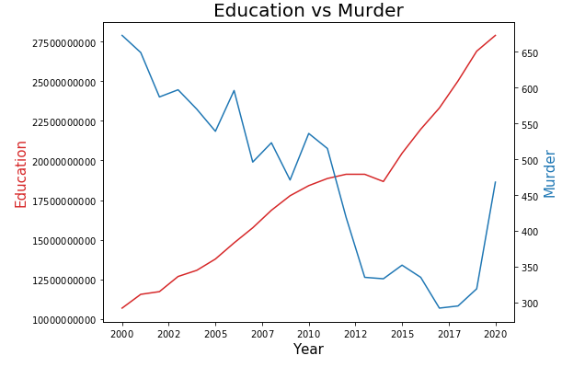
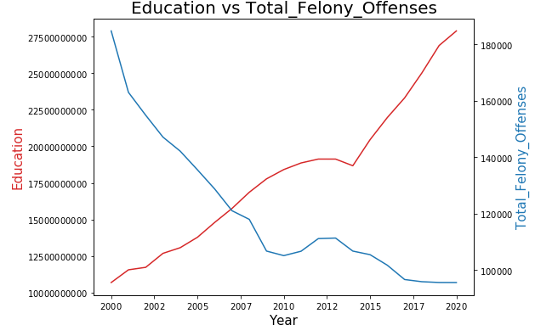
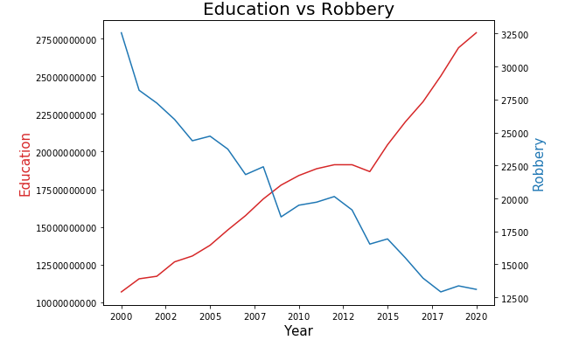
Education Spending vs Crime

Slide 15
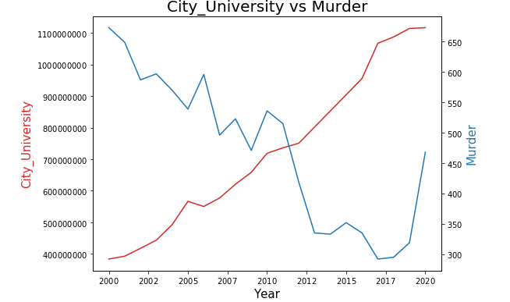
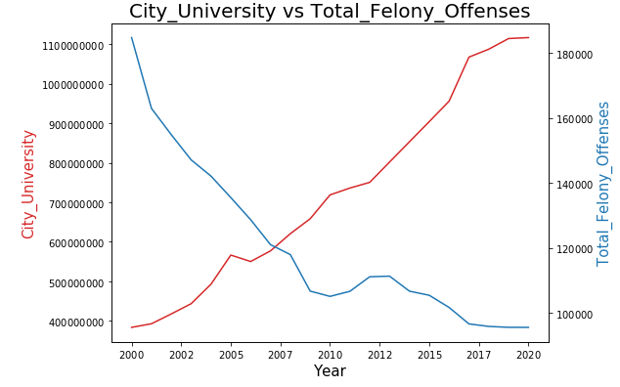
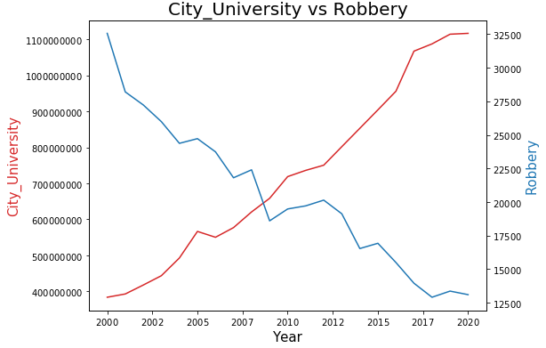
City University Spending vs Crime

Slide 16
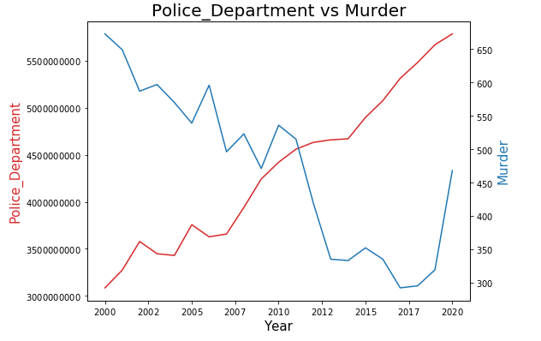
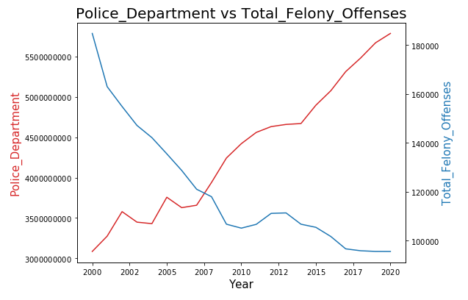
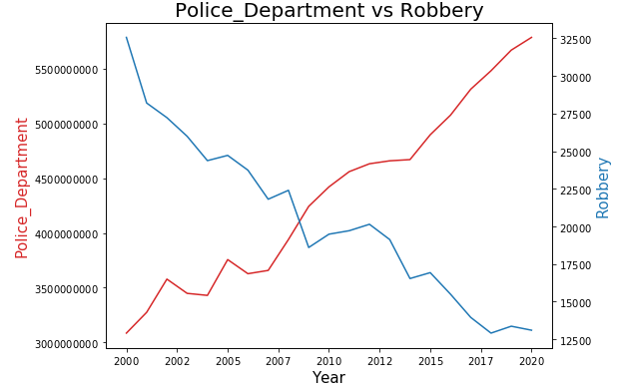
Police Spending vs Crime

Slide 17
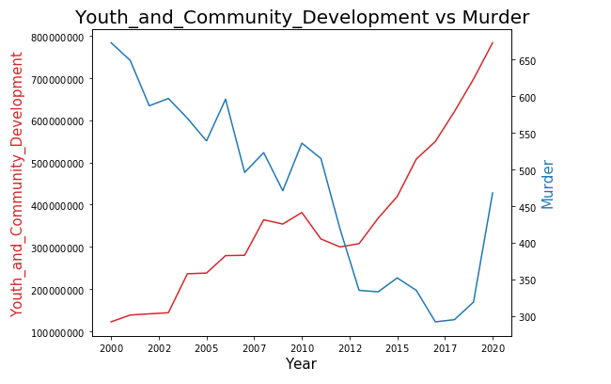
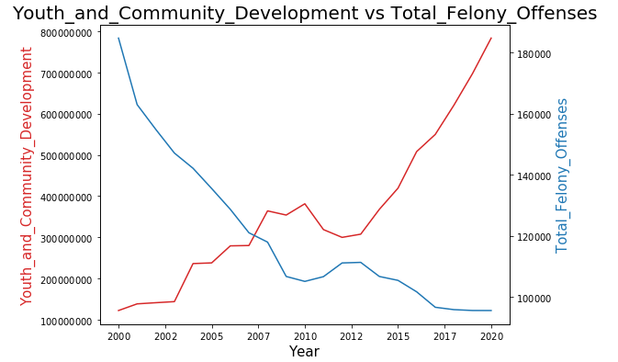
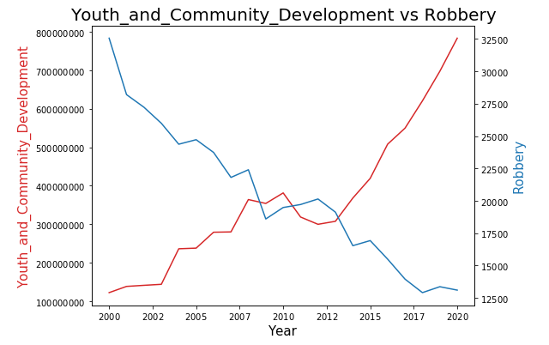
Youth and Community Spending vs Crime

Slide 18
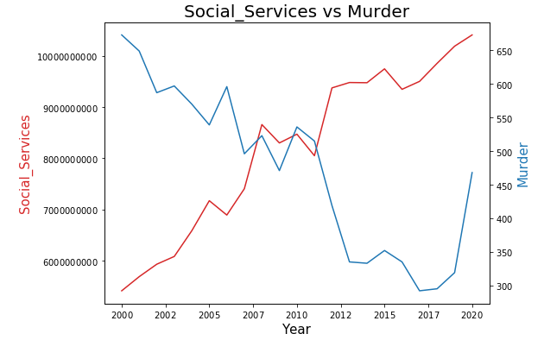
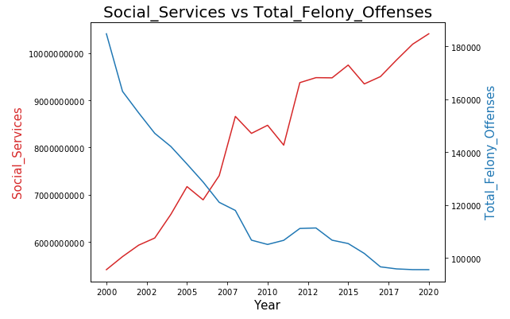
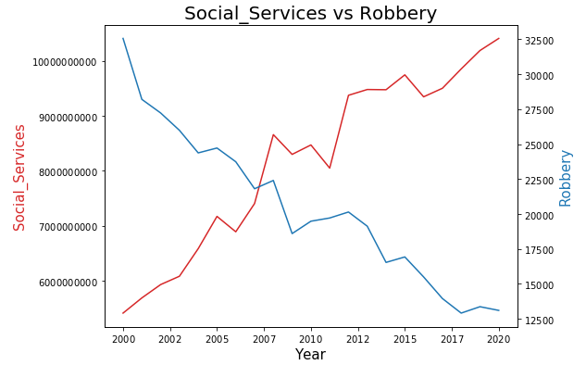
Social Services Spending vs Crime

Slide 19
Conclusions
Given the visuals and information graphics provided, we can support that there is a relationship between spending and crime levels.
The data supports spending has grown rapidly over the time period, while the levels of crime have all fallen over time. This could mean higher spending on students for education and heightened police activity has reduced the number of crimes being actioned. The only exception is murder, where over the last few years the murder rate has grown. These conclusions are correlations but don’t necessarily mean a causation in practice. The city could spend and get little results, while a confounding reason could be causing reduced crime. However it seems likely spending has made a significant impact on reducing the level of crime activity.

Slide 20

Thank You
Any questions or concerns?

Slide 21
Sources Used
Agency Expenditure Data:
https://comptroller.nyc.gov/wp-content/uploads/2020/10/7-General-and-Capital-Fund-Detailed-Schedules-of-Revenues-and-Expenditures-2020.pdf
Crime Data:

